Slide 1
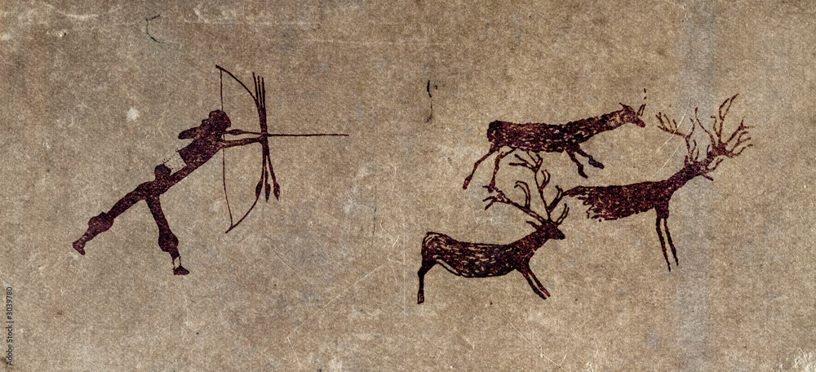
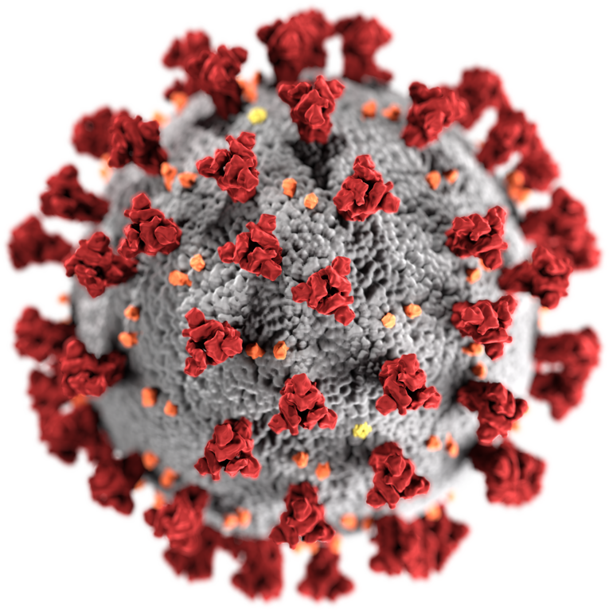
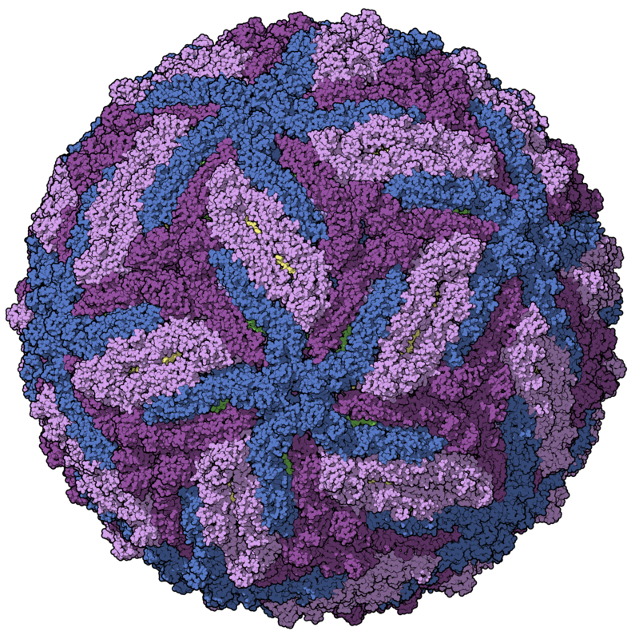
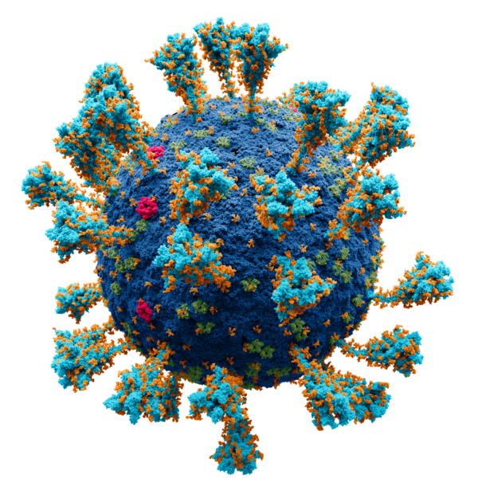
Characterization of the virome after liver
transplantation
VirushunterGatherer and Virusparies
Sergej Ruff
Twincore - RG Computational Virology
6 June 2024
Notes:
→ Good Morning
→ Today, Presenting the current progress of my master thesis, which I started almost 2 months ago.
→ Topic is the characterization of the virome after liver transplantation
→The Taubert Working Group at the MHH were so kind to provide me with liver Sequencing data
→ and I am applying VirushunterGatherer to characterize the virome of those samples and maybe find novel viruses.
→ Then I am plotting and analysing the output using a small R package I created called Virusparies.

Slide 2
Characterzation of the virome,VirusHunterGatherer and Virusparies - Outline
Introduction
Background: Importance of Viral discovery
History of viral discovery
Summary and Goals
Methods and Material used
Data
Workflow
Hittables
Results
SRA Data
Taubert
Virusparies Package
4. Conclusion and Outlook
Notes:
The outline of the presentation
Follows the classic Paper/ Journal Structure.
First → Talk about the motivation behind virus discovery.
Second → Then I want to talk about the history of viral discovery real quick and how it applyes to vhvg.
Method → Talk about the data and changes made to VhVg. Present the output of VhVg that I used for further analysis.
Results
Conclusion and Outlook.

Slide 3
Introduction
Why do We need virus discovery?
Notes:
→ Start with Intro.
→ (click): Why do we need Virus discovery
→ An obvious Reason is the discovery of disease causing viruses → Especially Pandemic causing once (click)

Slide 4
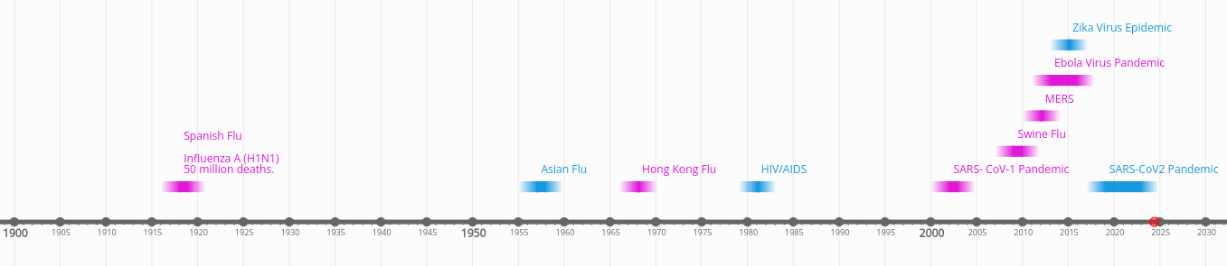
Introduction: Importance of Viral discovery - Pandemics
“Earlier, large-scale epidemics spanning various continents were a twice or thrice a century phenomenon, but we have experienced 6 major pandemics in the last 20 years itself.”
Bhadoria P, Gupta G, Agarwal A. Viral Pandemics in the Past Two Decades: An Overview. J Family Med Prim Care. 2021 Aug;10(8):2745-2750. doi: 10.4103/jfmpc.jfmpc_2071_20. Epub 2021 Aug 27. PMID: 34660399; PMCID: PMC8483091.
Notes:
And there is a need for Tools and methods for quick and efficient virus discovery.
Plot of the major pandemic caused by viruses since 1900.
Spanish Flu caused by Influenza A virus h1n1 → 1918
Asian Flu pandemic caused by Influenza A virus H2n2 → 1957
Hong Kong Flu H3N2 → 1968
HIV → 1981
BUT (Click) The frequency of pandemics increased drasticly (Quote)
enchanced globilazation air travel ncreasing population entering animal habitats.
Need for Tools that can help identify potential pandemic causing viruses.
History of virus: Do I find an virus I find in humans in other animals.

Slide 5
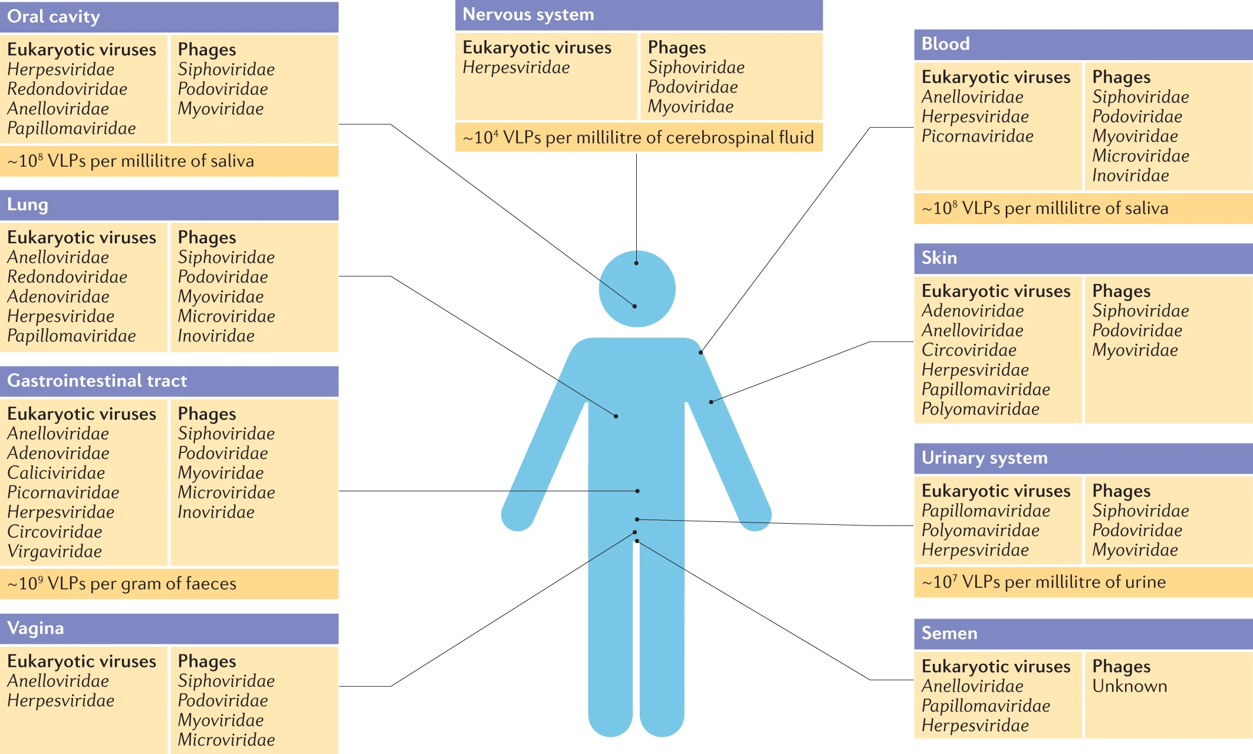
Liang, G., Bushman, F.D. The human virome: assembly, composition and host interactions. Nat Rev Microbiol 19, 514–527 (2021). https://doi.org/10.1038/s41579-021-00536-5
Introduction: Importance of Viral discovery - Virome
approximately 10¹³ particles per human individual.
High heterogeneity across different body sites
Infecting our cells and cellular microorganisms.
“ Despite increasing focus, it remains the case that the majority of sequence data in a typical virome study remain unidentified, highlighting the extent of unexplored viral ‘dark matter’.”
Notes:
Viruses coming from outside the body are not the only reason why we need virus discovery.
Everyone here carries 10 to the power of 13 viral particles on us spread across different body sites with high hetereogeneity.
Those viruses infect our cells or microorganisms on or inside our body.
Here is another quote from the same paper I use the image from.
Better Understanding of viral interactions with our body or our microbiome requires the identification of said viruses, which are part of the viral dark matter.

Slide 6


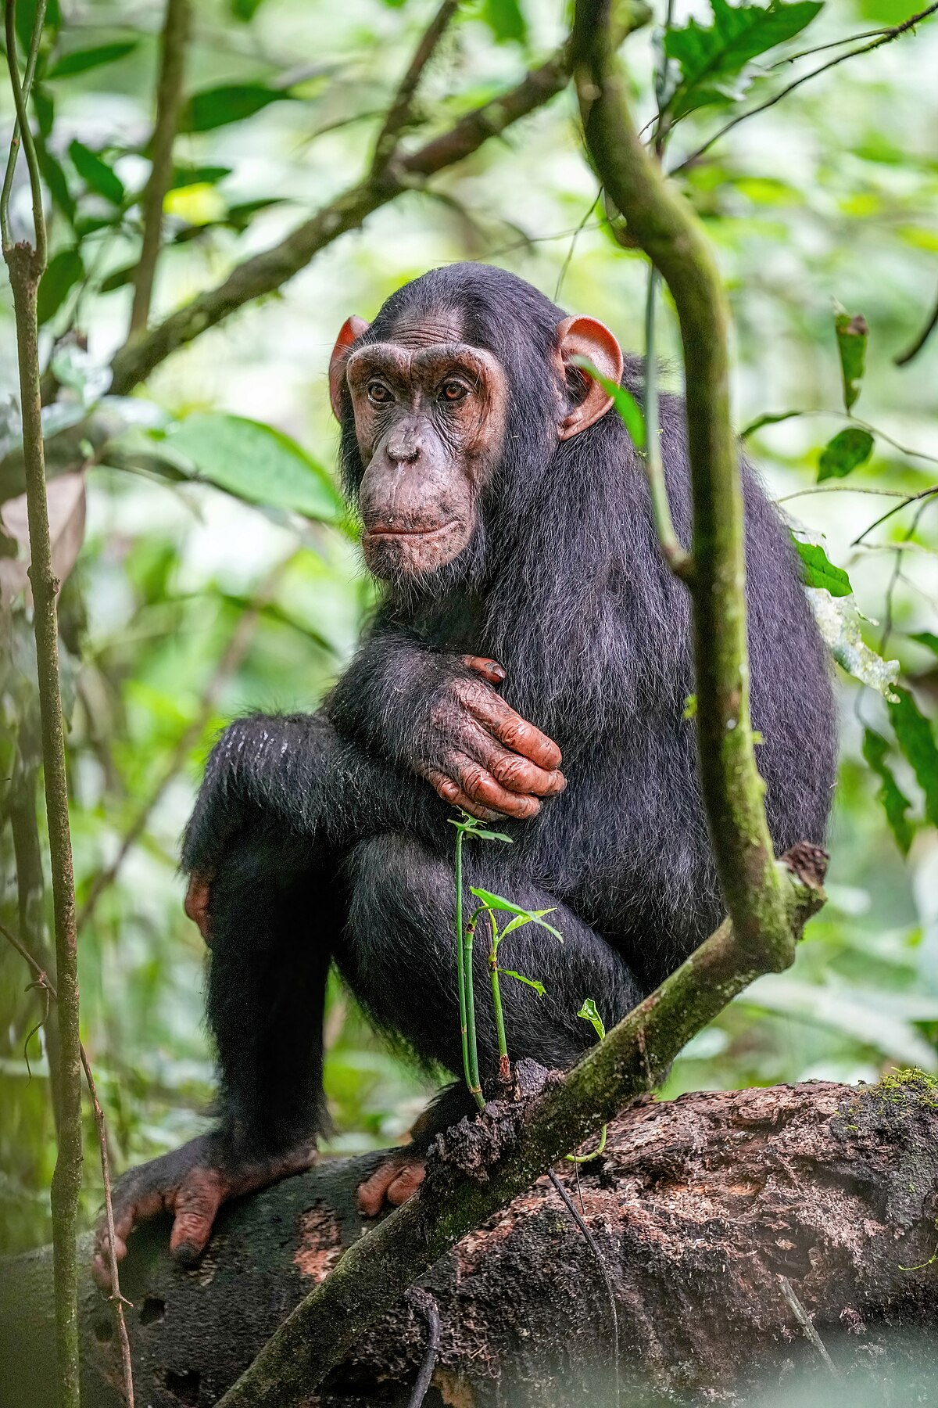
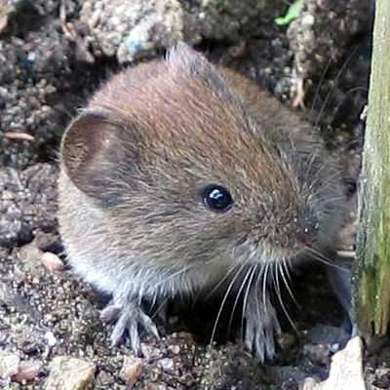
Introduction: Importance of Viral discovery – new model organisms
Endangered!
In 2017, approximately 71 million people were infected with HCV (WHO . Global Hepatitis Report 2017. WHO; Geneva, Switzerland: 2018.).
Liver fibrosis: abnormal buildup of extracellular matrix proteins in the liver, often leading to liver failure and cirrhosis.
Hepatocellular carcinoma (HCC) → liver cancer.
Surrogate
GBV-B
?
Drexler et al., 2013
Notes:
We also need viral discovery for Identification of new model organisms and surrogate viruses.The example I want to bring here is hepatitis C. 71 Million people are infected and suffer from liver fibrosis or worse case complete liver failure or liver cancer.Currently treated with direct acting antiviral drug therapry targeting Serine protease, phrospoproteins and polymerase of the virus. Problem is the high cost of the therapy, leading to patients with no health coverage at risk. Opioid Crisis in USA lead to more infections.Need for vaccine.Cant use humans for clinical studies. Chimpanzeese were used. Problem is they are endangered and their use is restricted and in most cases not allowed.New animal models. Surrogate are the George Baker Virus B a positive sence single stranded RNA virus related to HCV flaviridae of genus Hepacivirus.

Slide 7
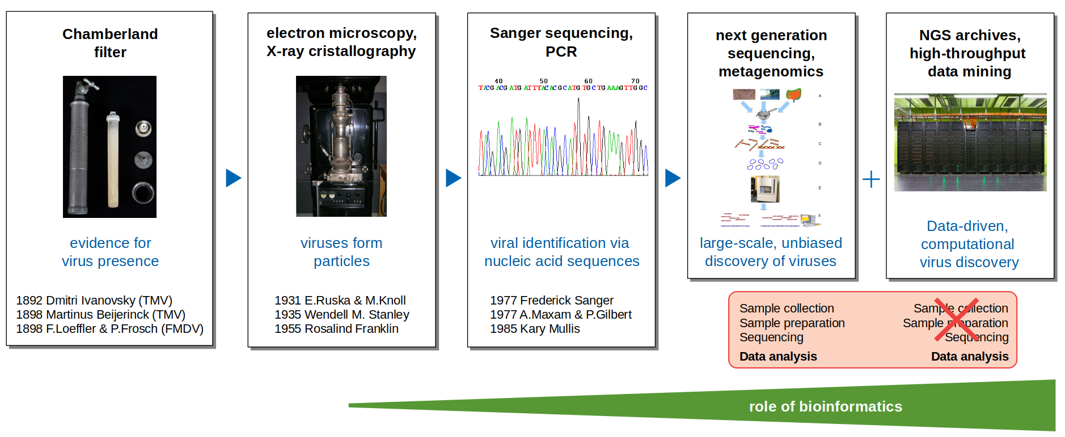
Introduction: History of viral discovery
Image taken from Prof. Dr. Chris Lauber.
Notes:
ok. After talking the motivation, I want to talk about the approach used here.
I borrowed the image from Chris Prasentation. Thanks you for that
Viral discovery started with Dmitry Ivanovsky. He liqudized tabacco plants with tabacco mosaic disease and ran it through a filter which held back bacteria. Then he used the filtered liquid on new plants and discovered that they also develop the disease. Thats how the tabacco virus was first discovered. Actual characterization of viruses happened with later technologies. X-ray cristallography allows structure analysis and Sequencing technologies allowed for indetification on nucleotide level.
Viral discovery develops as new technologies develop.
Data driven approach → independent and complementary to lab work.
Apply VirusHunterGatherer → A tool that enables us to perform data driven dicovery.

Slide 8
Introduction: Summary and Goals
Importance of viral discovery
Identification of Novel Viruses During Outbreaks.
Better Understanding of the Virome.
Exploring Novel Model Organisms for Studying Human Viral Infections.
New data-driven viral discovery is complementary to wet lab experiments, utilizing publicly available data.
Goals:
reproduce old results.
Utilize VirusHunterGatherer on the Taubert Dataset to analyze and characterize the virome.
Notes:
The goal was to first perform literature review and reproduce existing results. Make sure that I can work with Virushuntergatherer.
Then I started applying VhVg to the Taubert data.

Slide 9
Methods and Material used
Notes:
ok. lets talk about the methods I used, but first the data.

Slide 10
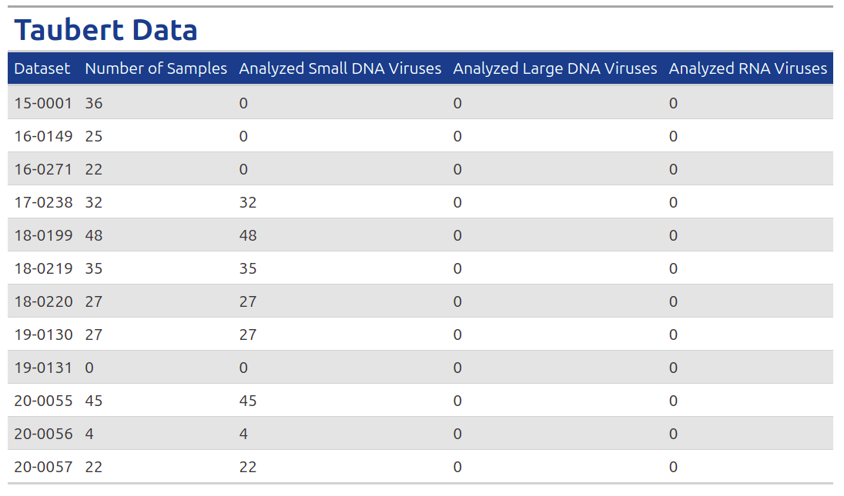
- 12 folders
- 323 Samples
Methods and Material used: Data
SRA-Files: 9
ERR206007
ERR206021
SRR10822543
SRR10822546
SRR10822547
SRR10822552
SRR10822560
SRR10822564
SRR12567985
Klinik für Gastroenterologie, Hepatologie, Infektiologie und Endokrinologie→ AG Taubert
Notes:
First I got 9 SRA-Accesions from Chris. Chris analyzed those files already in May.2022 and provided me with the output. I tried to reproduce the results.
Taubert → liver data.
Both were analyzed for small dna viruses first
Taubert small dna is already done.

Slide 11
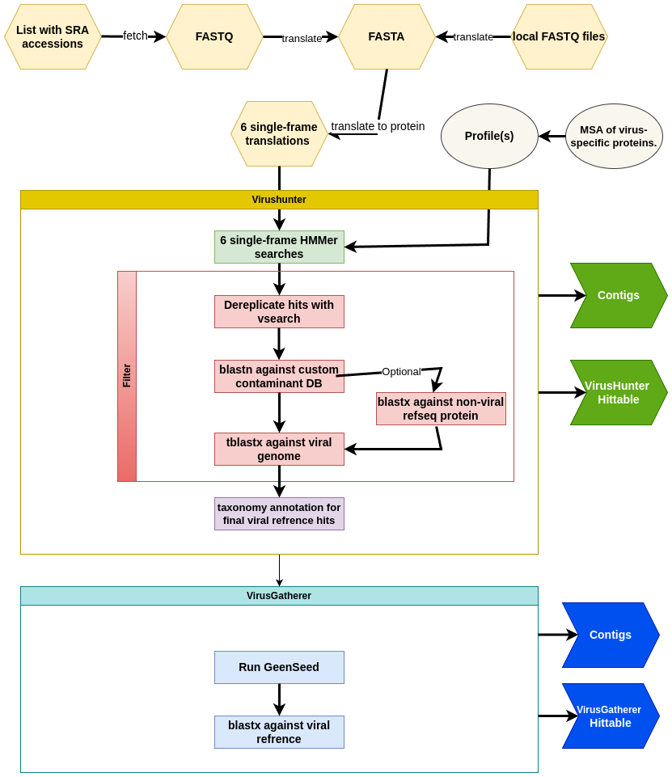
Methods and Material used: VirusHunterGatherer Workflow
Local FASTQ files.
SRA fetch.
QC with fastp (not shown).
Summary Statistics.
Visualisation.
VirusHunterGatherer available here: https://github.com/lauberlab/VirusHunterGatherer
Notes:
Virushuntergatherer divided to Hunter – performing sensitive homology utilizing profile Hidden Markov Models, 3 filtering steps and taxonomic annotation. Virusgatherer performs iterative assembly using contigs from Hunter as seeds.
→ Important: Takes both local and SRA Accesions. We updated VhVg to make the filter against host optional. Hittables used for further analysis.
Analysis = Right generate plots Summary Statistics.

Slide 12
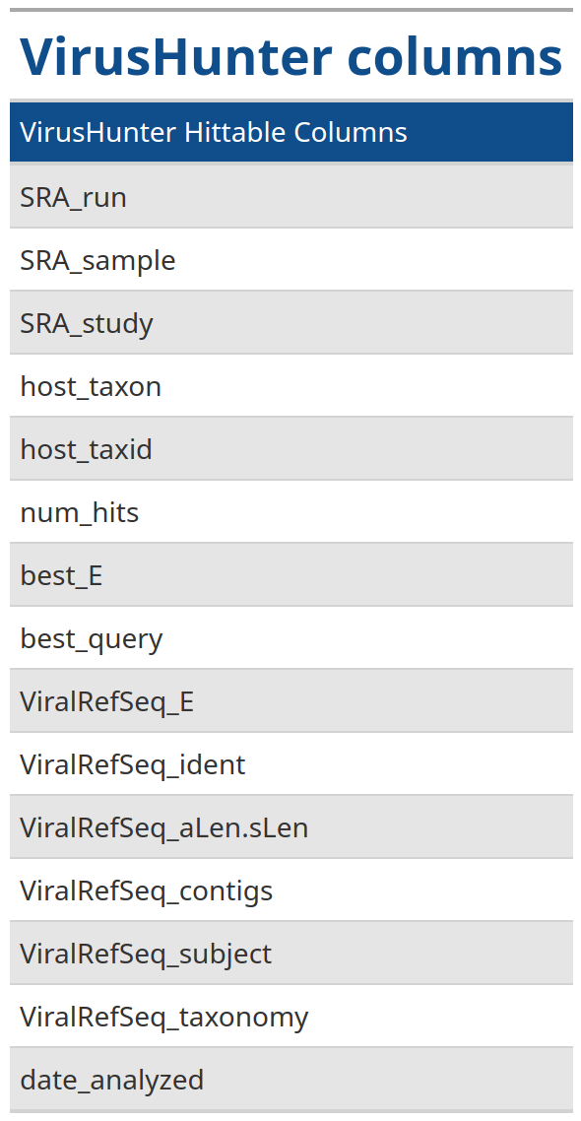
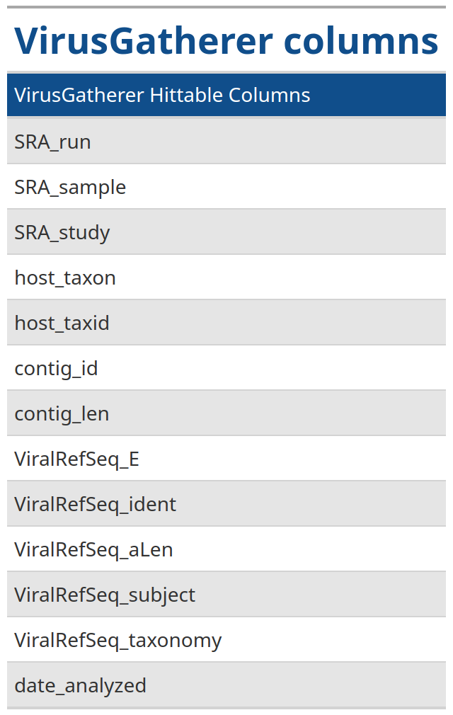
Methods and Material used: VirusHunterGatherer Hittables
Vh Hittable → 15 columns
Vg Hittable → 13 columns
Local files: "run_id" column
Important columns
- SRA_run/run_id
- best_query
- num_hits
- ViralRefSeq_E
- ViralRefSeq_ident
- contig_len
Notes:
I mentioned that I use hittables as Input for further analysis.
Here you see hittable structure
→ SRA-run → SRA Acession ID
→ run_id → FatsQ name.
→ best-query → name of the best query for the SRA/FASTQ File.
→ NuM-hits → Number of contigs in a sample mapping against a query.
→ Best E value and Identity in % in the blast allignment against viral sequences
→ gatherer : Contig length after assembly.

Slide 13
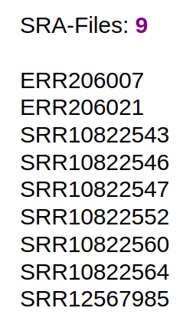

Methods and Material used: What I have done so far
Smalldna virus
vHvG
Hunter Hittable
Virusparies
1.
Smalldna virus
Taubert
vHvG
Hunter Hittable
Virusparies
2.
Notes:
To summarize → Reproduced the results for SRA and then started running Taubert data.
Both for smalldna first.
Then I generated Plots and summary statistics which I all added as functions in a R package I developed.

Slide 14
Results: SRA Data
Notes:
Ok. Start with SRA results.
As a reminder: Here I want to reproduce Chris old results from 2022.

Slide 15
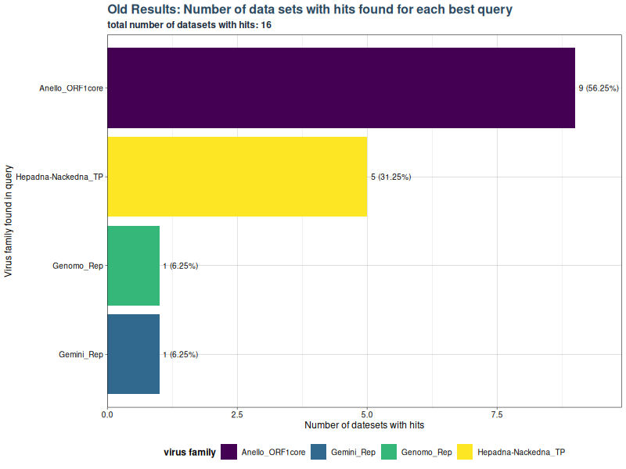
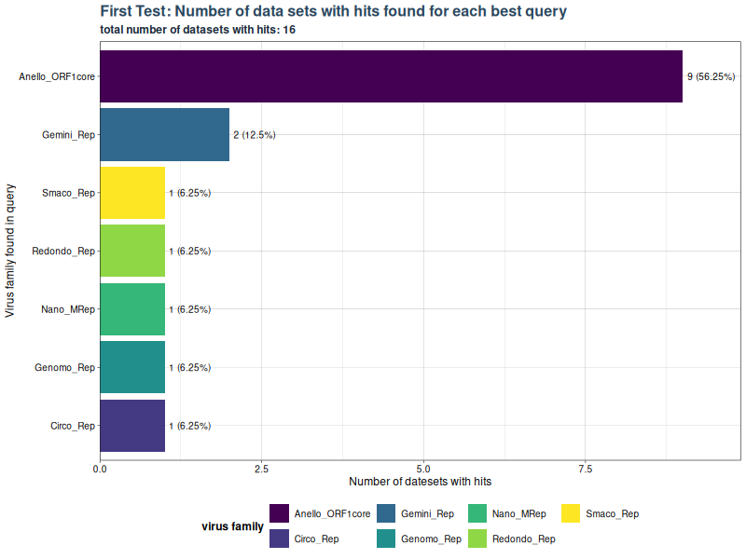
Results: Number of Runs finding specific virus group
No Hepadna-Nackedna?
Notes:
On the left you see Chris old results in a plot.
Plot shows number of SRA runs which have hits for specific group in best_query.
We had 9 SRA Accesions → meaning 9 files.
All 9 files find Anello ORF 1.
First → no hepadna.
We tried to solve the issue
Updating the refrence databases we use for filtering
Making filter 2 optional
Now I want to present results for both tests.

Slide 16
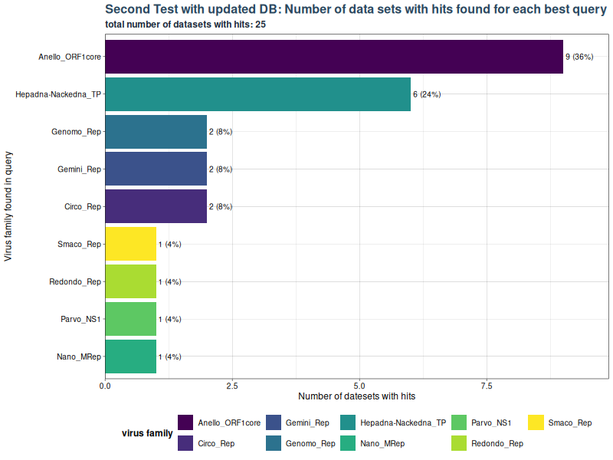
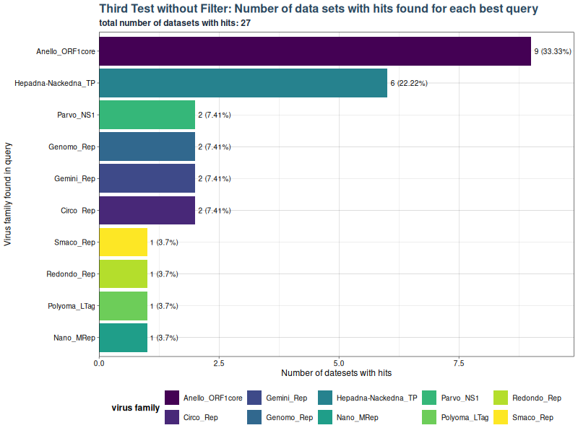
Results: Number of Runs finding specific virus group
NO FILTER GOING FORWARD!
Notes:
Update to the filter → Found Hepadna.
→ 6 datasets find Hepadna not 5.
Find more Hits over all → Genomo and Gemini have 2 not 1
More viruses overall.
Without filter → Also found Hepadna.
→ 1 more Parvo virus
→ Polyoma-LTag

Slide 17
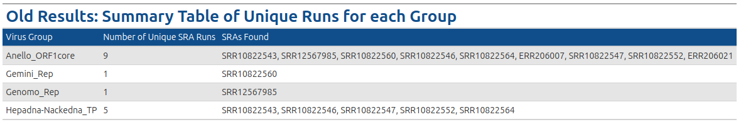
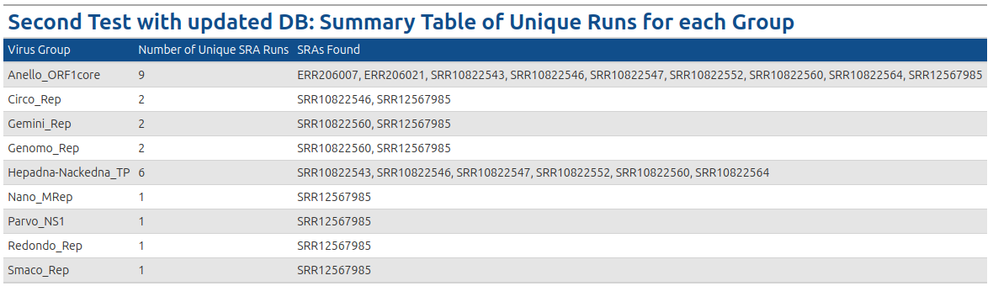
Results: Number of Runs finding specific virus group - Tables
SRR10822560
now finds Hepadna_Nackedna_TP
Notes:
Here you see the summary table for the previous plot.
→ I mentioned the new tests find 6 files with hepadna viruses. I wrote a small function to find which sets have hits for a specific virus group.
→ here is the exta file.

Slide 18
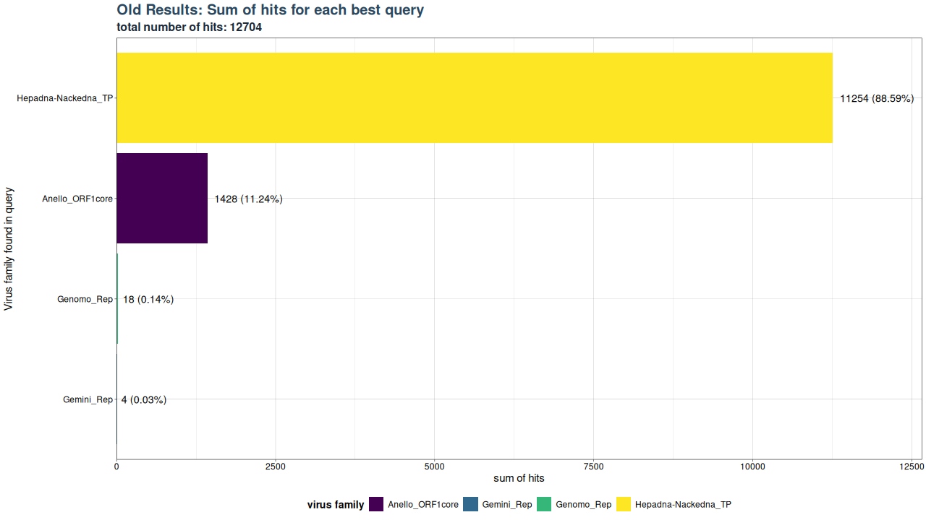
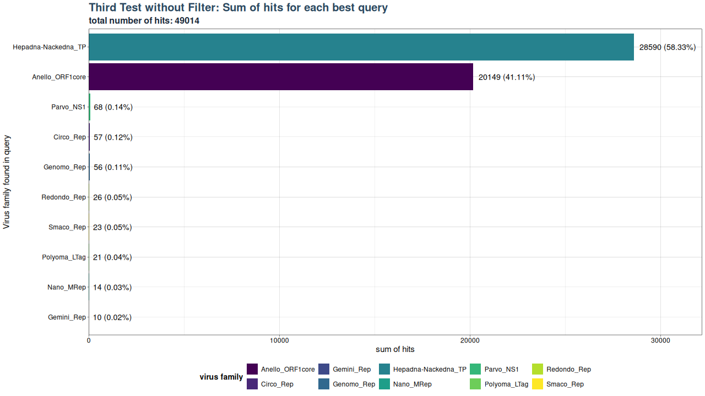
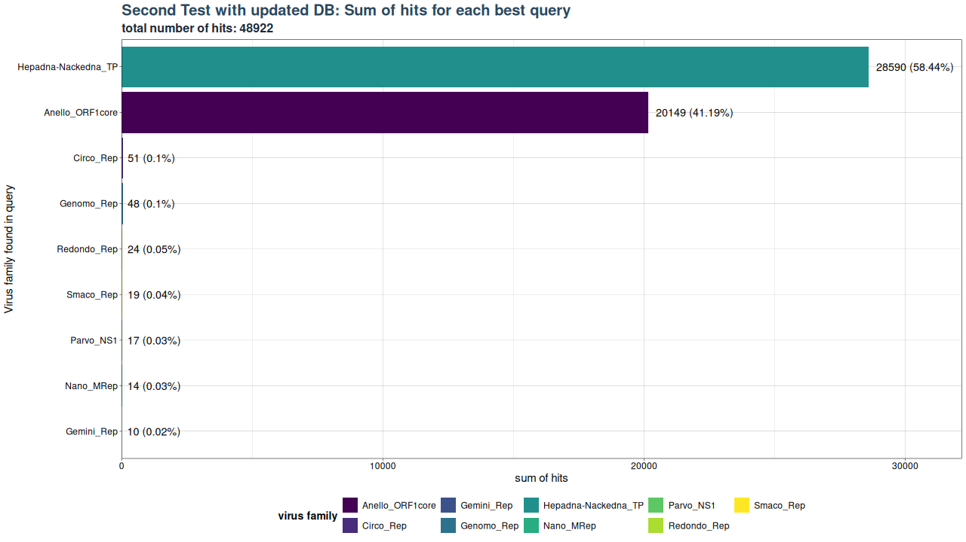
Results: Number of Hits for each Group
Polyoma_LTag?
Notes:
Then, I plotted how many Hits over all are found for a specific group in best_query.
→ New tests find both 4 times more hits
→ more viruses.
→ Percentage of hits changes
→ Due to updated Database.
→ Next I wondered why I find Polyoma_Ltag without filter but not with the filter on.

Slide 19
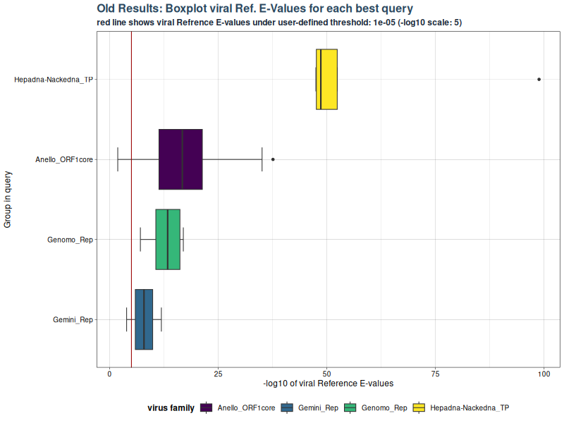
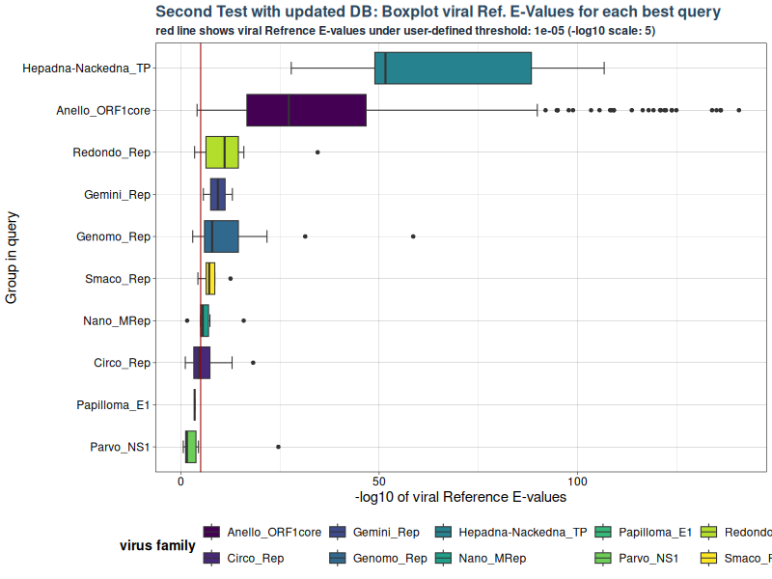
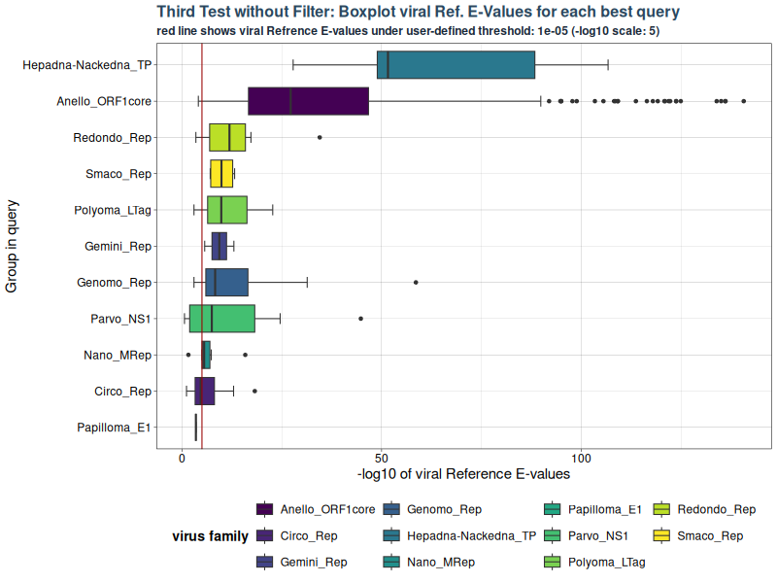
Results: Boxplot – RefSeq E-Values
Notes:
→ To find that out, I plotted the E-values in a boxplot for each virus group in best_query.
→ E values are in -log10(scale).
→ you see Hepadna has around 10⁻50
→ In test 2: papilloma and parvo above the threshold → False positives.
→ Polyoma-Ltag → significant, but really close. Talked to Chris → Sequences similar to host helicase. Might be a false positive.

Slide 20
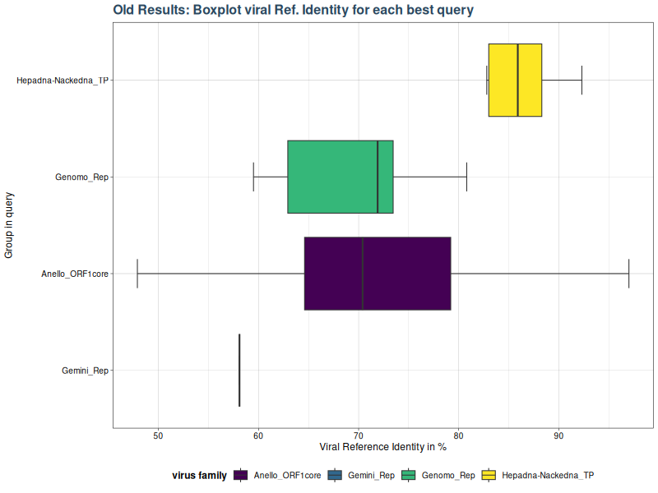
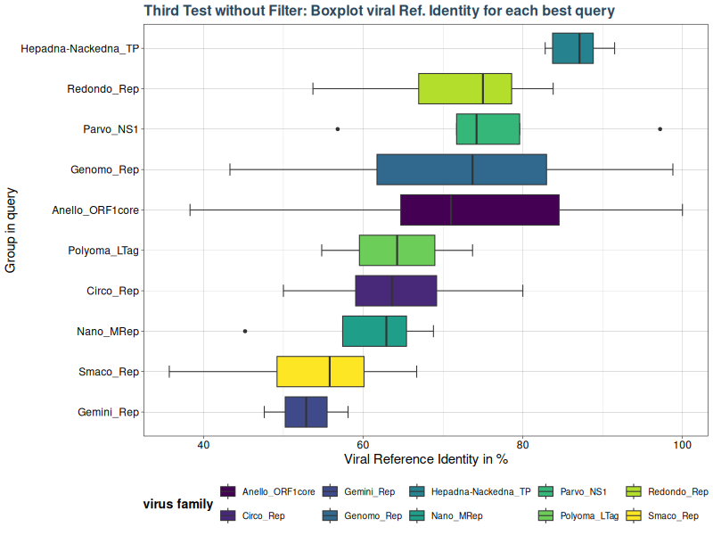
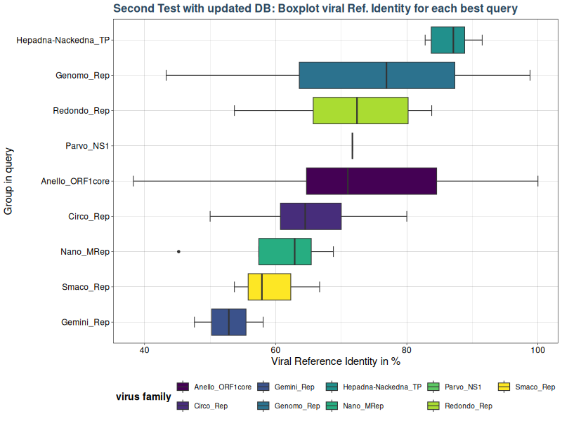
Results: Boxplot – RefSeq Identity
Notes:
Similar results for the groups.
→ larger boxes because more data.
→ both tests returned similar results.

Slide 21
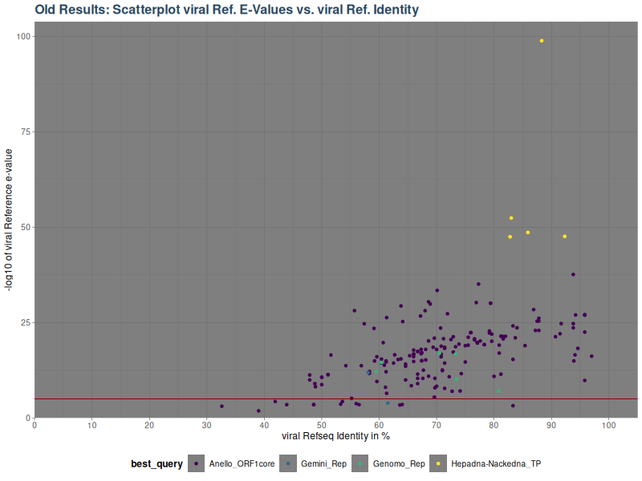
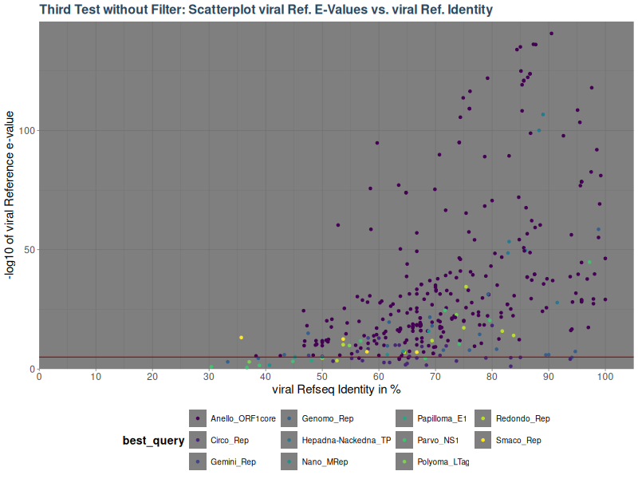
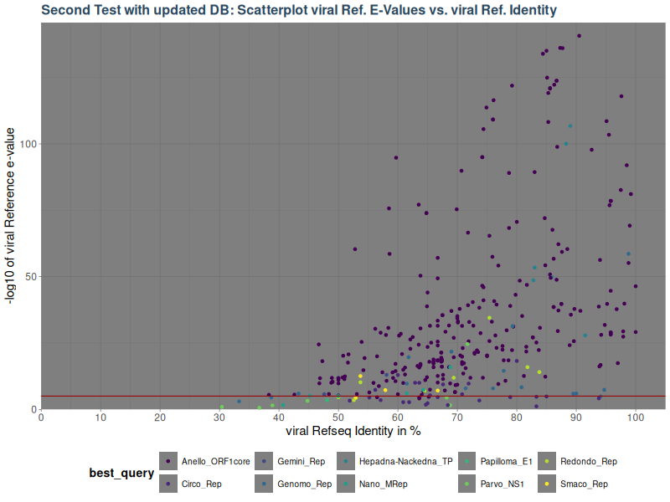
Results: Scatterplot – E-Values vs. Identity
Notes:
Scatter plot for identity vs E value.
You see a clear seperation for hepadna.
In Test 2 and 3 there is more Anelloviruses with higher E-values. That seperation disappears.

Slide 22
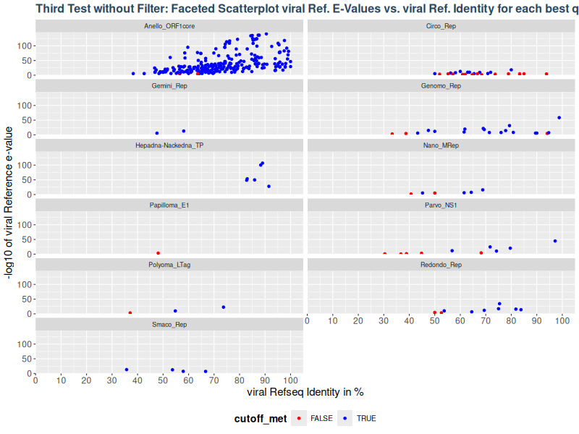
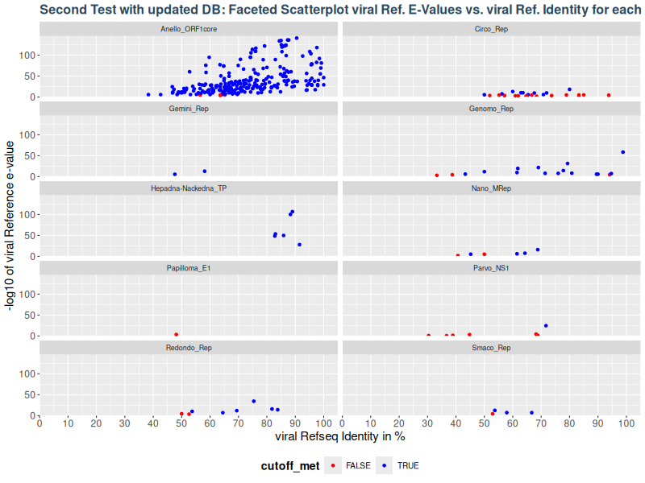
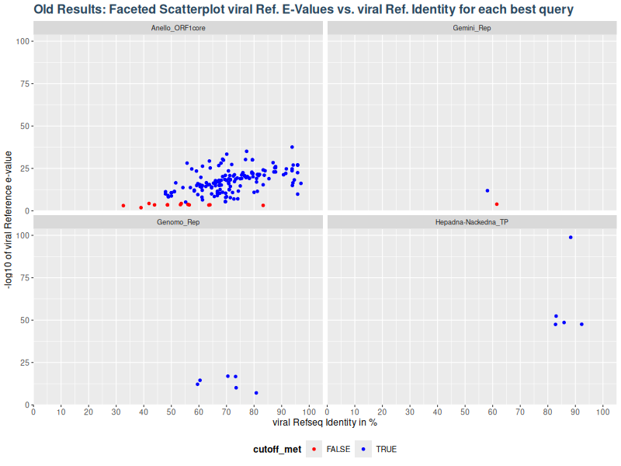
Results: Faceted Scatterplot – E-Values vs. Identity
Notes:
So I created faceted scatterplot to see if Hepadna still maps similar to the original data. I want to seperate the Hepadna data from the Anello-dots covering them and see if the pattern is similar.
It does for both.

Slide 23
Results: SRA data Summary
First Test did not find Hepadna-Nackedna.
Updated DB (Test 2) and made Filter against Host optional (Test 3).
Test 2 and Test 3 returned similar results.
Hepadna now in 6, not 5 Runs.
Find more Hits → due to new DB?
Find Polyoma_Ltag → False Positive.
Decision to remove Filter going forward → Filter out false positives downstream.

Slide 24
Results - Taubert
Added Feature to run local FASTQ-Files.
Only 3 Taubert Folders returned Hittables with results for smalldna viruses.
Notes:
Old version had a mendatory filter against a host. That was removed here.

Slide 25
Results: Taubert
19-0131 is empty = 11 files.
Only 3 returned non-empty Hittables.

Slide 26
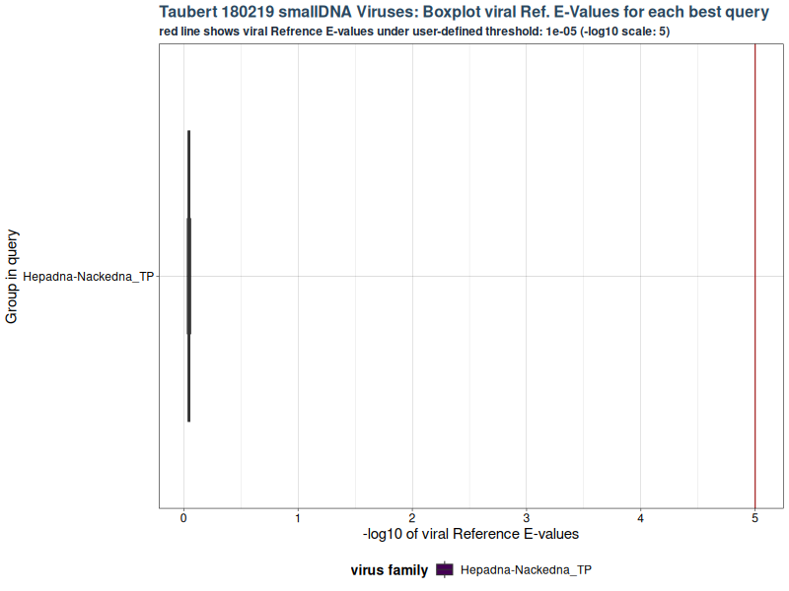
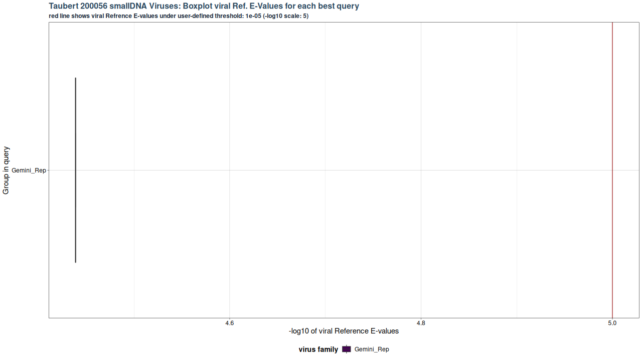
Results: Taubert

Slide 27
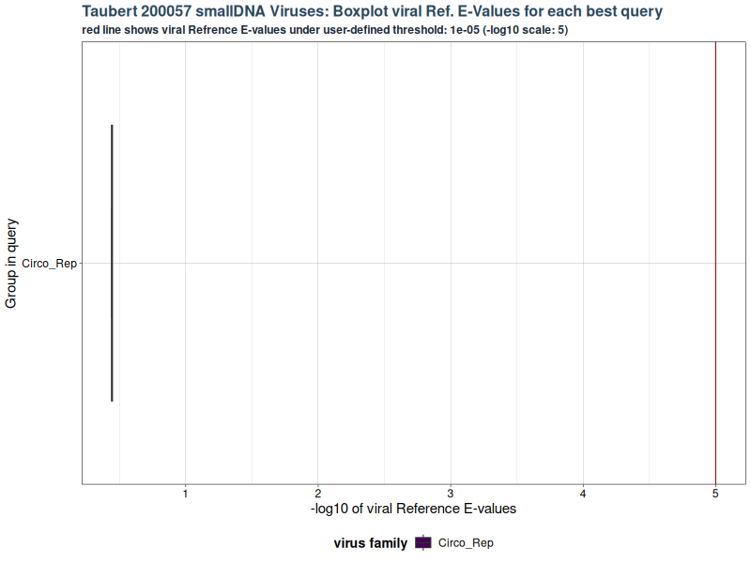
Results: Taubert
Three Hittables, but none of them return results below the threshold (1e⁻⁵).

Slide 28
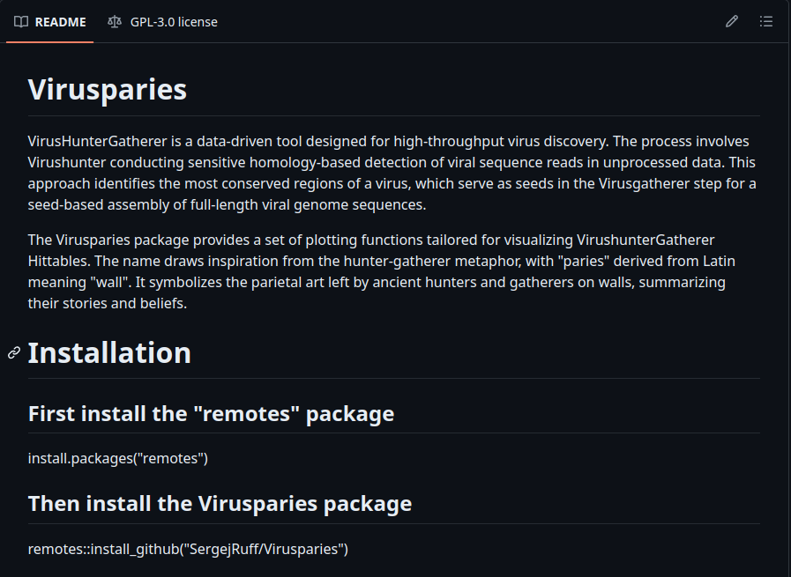
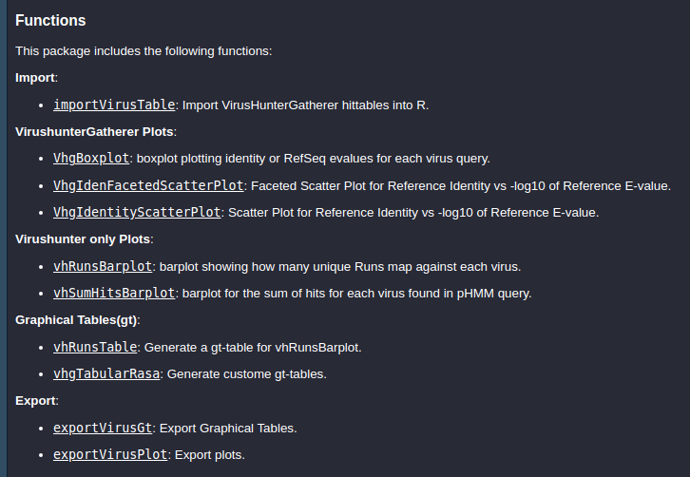
Results: Virusparies
Virusparies available here: https://github.com/SergejRuff/Virusparies

Slide 29
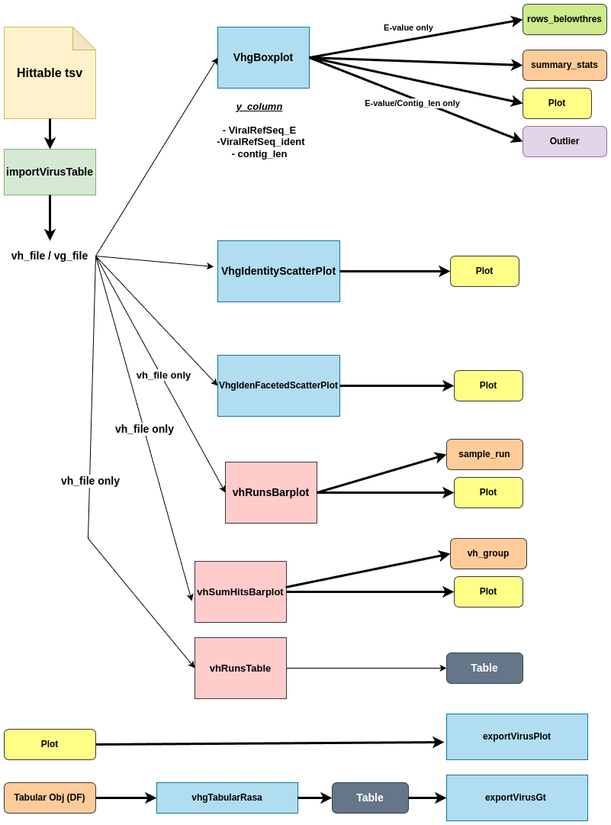
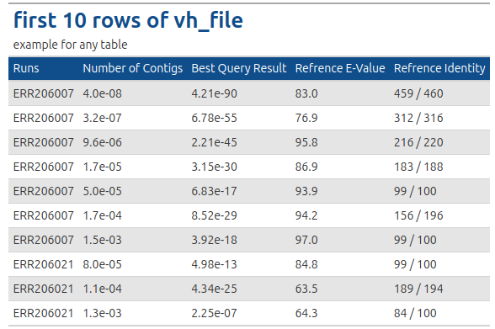
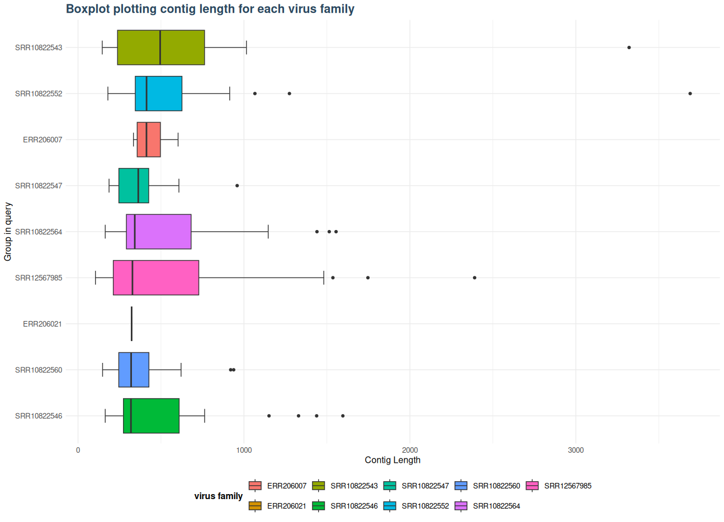
Results: Virusparies
Notes:
Cutoff in E value returns the hline
For contig_len and identity the cutoff filters the data and only plots the data under the threshold.

Slide 30
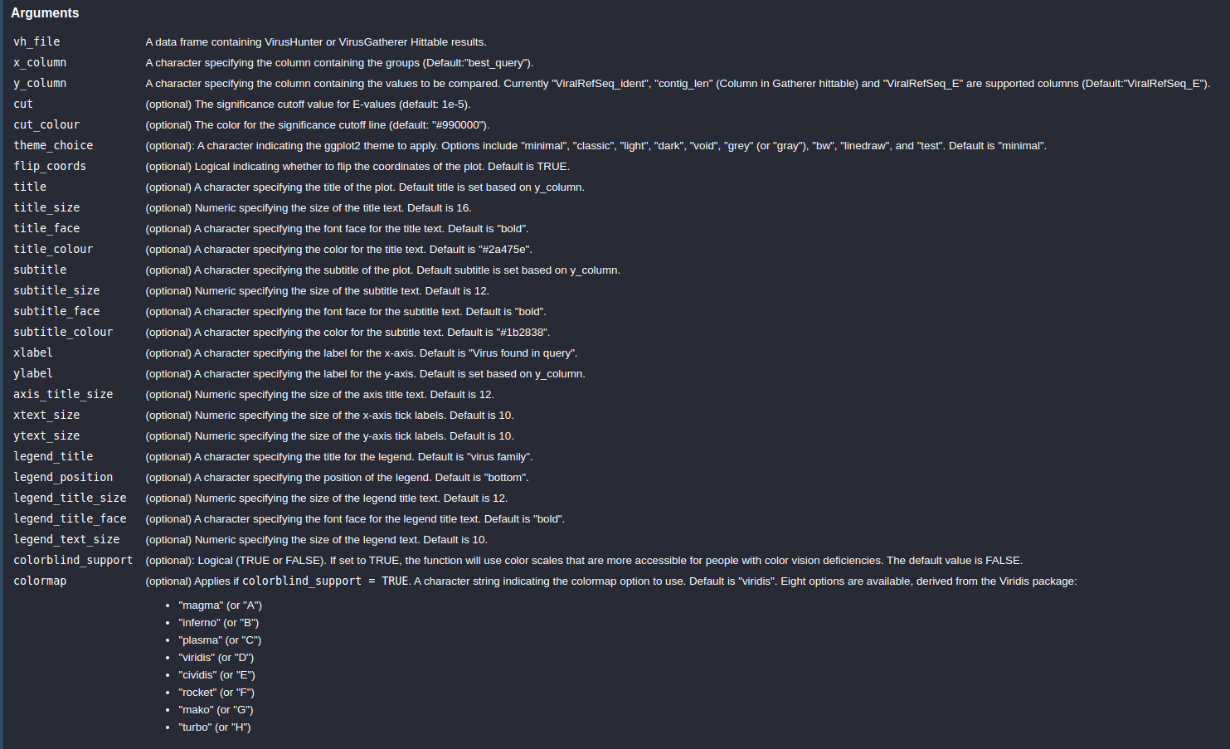
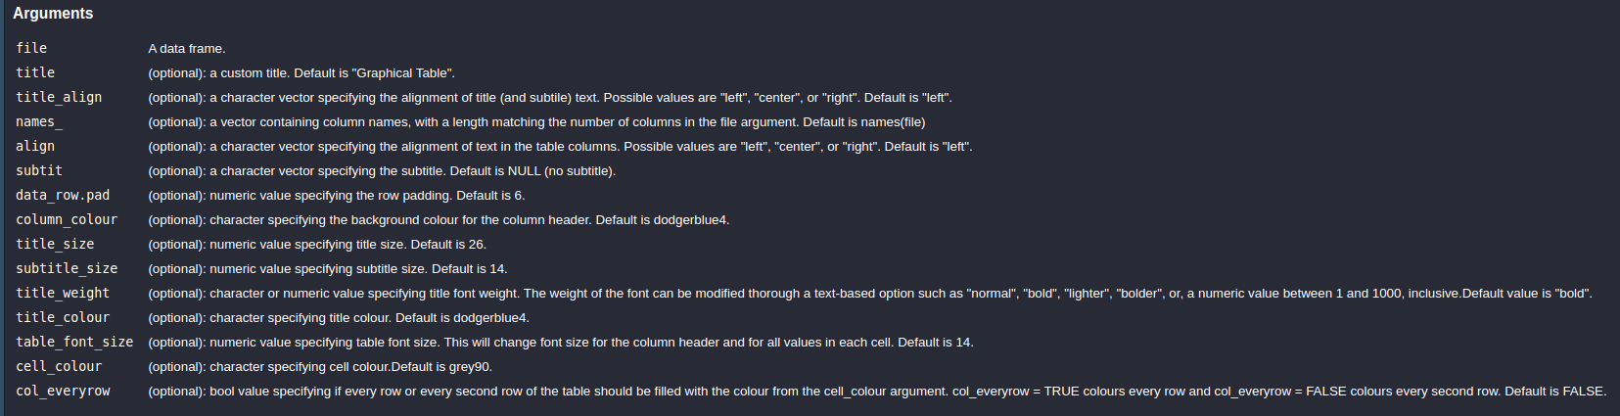
Results: Virusparies - Customization
GT Customization
→ 14 Options
Plot Customization
→ 23 Options
Notes:
I added some customization
For plots and Tables
Colorblind modus.

Slide 31
Conclusion and Outlook

Slide 32
Conclusion
→Reproduced SRA Results *.
→Filter and No Filter options yield similar results for SRA data.
→ Taubert Runs for small DNA viruses returned no significant results.
→ Virusparies.

Slide 33
Outlook
Small DNA, large DNA, and RNA virus runs for Taubert data.
→ If no results are obtained, use animal data.
Improve Virusparies → better Documentation, future Features.
Meeting with Taubert.

Slide 34
Thank you for your time! Any Questions?

Slide 35
Sources
Images used for the title page:
Prehistoric hunter- cave painting : https://stock.adobe.com/images/prehistoric-hunter-cave-painting-reproduction/3039780 (Last accessed June 2, 2024, at 19:01).
Zika 3D reconstruction: https://de.wikipedia.org/wiki/Zika-Virus#/media/Datei:Zika-chain-colored.png (Last accessed June 2, 2024, at 19:01).
Coronavirus SARS-COV2.png: https://de.wikipedia.org/wiki/Datei:Coronavirus._SARS-CoV-2.png (Last accessed June 2, 2024, at 19:01).
SARS-COV-2 without background.png : https://de.wikipedia.org/wiki/Datei:SARS-CoV-2_without_background.png (Last accessed June 2, 2024, at 19:01).
Introduction: Importance of Viral discovery - Pandemics
Figure and information based on (modified): Bhadoria P, Gupta G, Agarwal A. Viral Pandemics in the Past Two Decades: An Overview. J Family Med Prim Care. 2021 Aug;10(8):2745-2750. doi: 10.4103/jfmpc.jfmpc_2071_20. Epub 2021 Aug 27. PMID: 34660399; PMCID: PMC8483091.
Introduction: Importance of Viral discovery – Virome
Figure and information sourced from: Liang, G., Bushman, F.D. The human virome: assembly, composition and host interactions. Nat Rev Microbiol 19, 514–527 (2021). https://doi.org/10.1038/s41579-021-00536-5
Introduction: Importance of Viral discovery – new model organisms
WHO . Global Hepatitis Report 2017. WHO; Geneva, Switzerland: 2018.
Berggren KA, Suzuki S, Ploss A. Animal Models Used in Hepatitis C Virus Research. Int J Mol Sci. 2020 May 29;21(11):3869. doi: 10.3390/ijms21113869. PMID: 32485887; PMCID: PMC7312079.
Drexler JF, Corman VM, Müller MA, Lukashev AN, Gmyl A, Coutard B, Adam A, Ritz D, Leijten LM, van Riel D, Kallies R, Klose SM, Gloza-Rausch F, Binger T, Annan A, Adu-Sarkodie Y, Oppong S, Bourgarel M, Rupp D, Hoffmann B, Schlegel M, Kümmerer BM, Krüger DH, Schmidt-Chanasit J, Setién AA, Cottontail VM, Hemachudha T, Wacharapluesadee S, Osterrieder K, Bartenschlager R, Matthee S, Beer M, Kuiken T, Reusken C, Leroy EM, Ulrich RG, Drosten C. Evidence for novel hepaciviruses in rodents. PLoS Pathog. 2013;9(6):e1003438. doi: 10.1371/journal.ppat.1003438. Epub 2013 Jun 20. PMID: 23818848; PMCID: PMC3688547.
Chimp Image: https://de.wikipedia.org/wiki/Gemeiner_Schimpanse#/media/Datei:015_Chimpanzee_at_Kibale_forest_National_Park_Photo_by_Giles_Laurent.jpg (Last accessed June 2, 2024, at 19:01).
Mario Image: https://www.freeiconspng.com/img/49310 (Last accessed June 2, 2024, at 19:01).
https://en.wikipedia.org/wiki/Bank_vole#/media/File:R%C3%B6telmaus.jpg (Last accessed June 2, 2024, at 19:01).
Methods and Material used: VirusHunterGatherer Workflow/ Results: Virusparies
VirusHunterGatherer available here: https://github.com/lauberlab/VirusHunterGatherer
Virusparies available here: https://github.com/SergejRuff/Virusparies

Slide 36
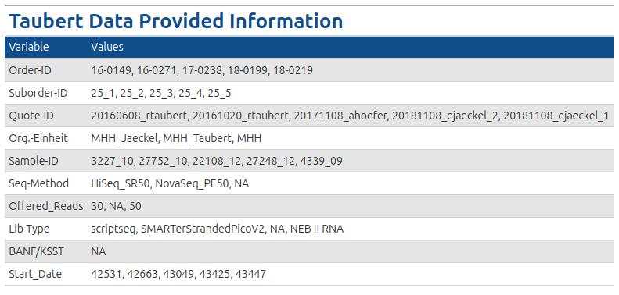
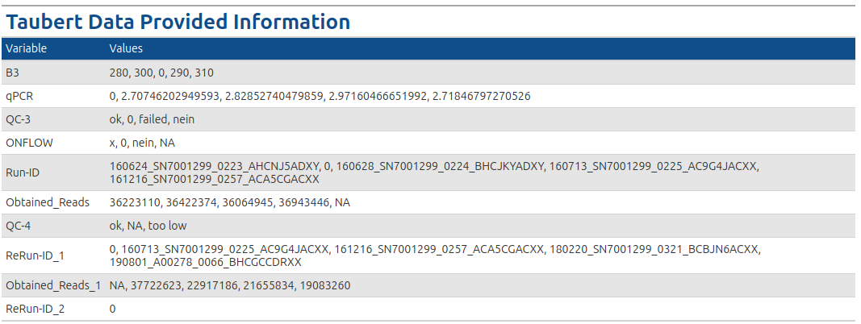
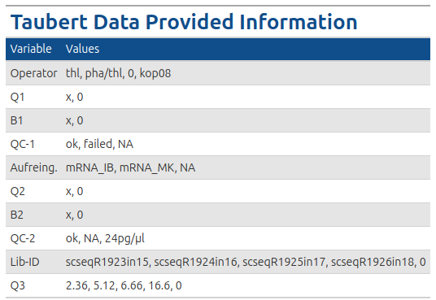
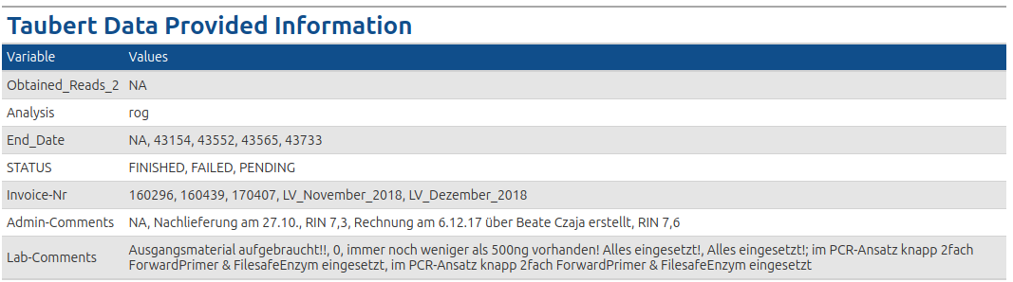

Slide 37
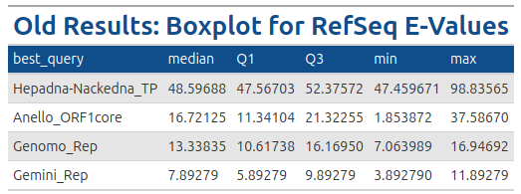


Results: Boxplot – RefSeq E-Values - Table

Slide 38



Results: Boxplot – RefSeq Identity - Table

